Slide 1
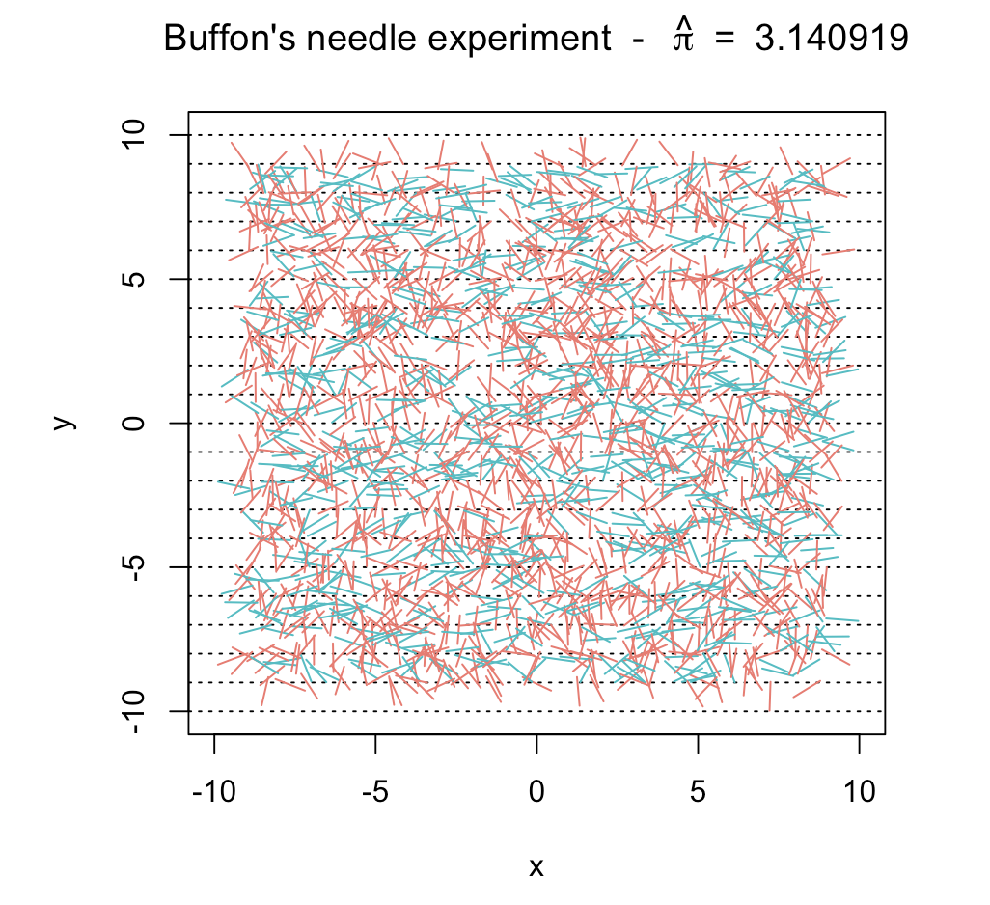
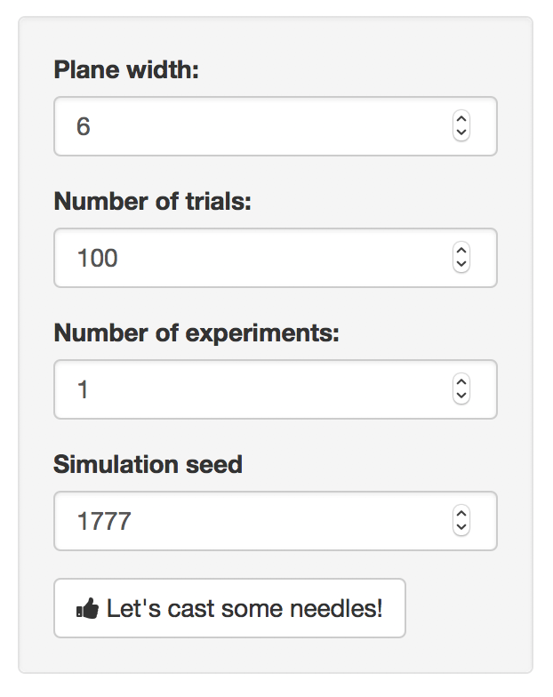
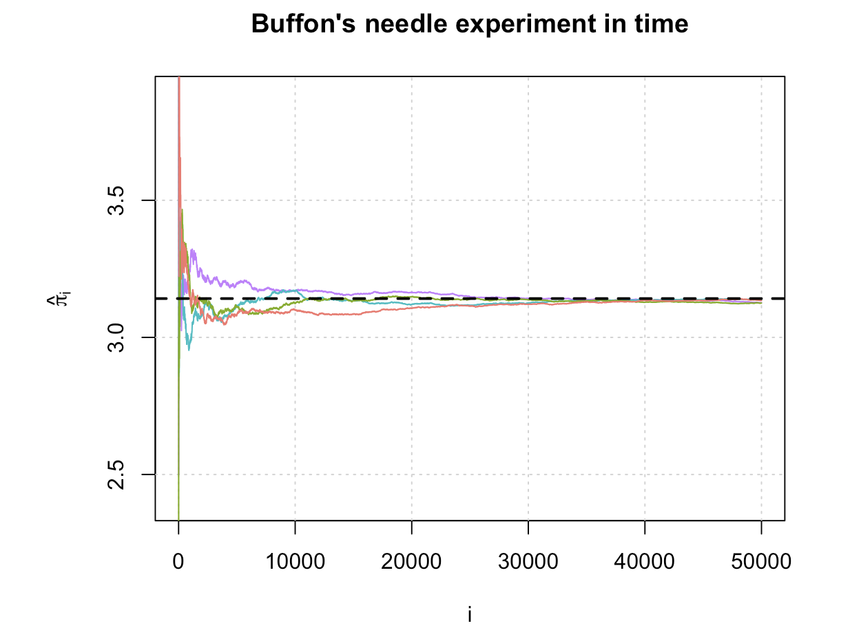
Shiny “back end” – hidden from app
Shiny “output” panels
Tab 1 - Experiment
Shiny “input” panel
input list
1) input$plan
2) input$B
3) input$seed
4) input$M
plot(buffon_needle())
Tab 2 - Convergence
Update seed
converge()
RUN

